Slide 1

The Scoop on Embedding: Teaching Large Language Models the “Flavor of the Day” at Culvers
Joe Steinbring
@joe@jws.social

Slide 2

How a Large language models is trained

Slide 3
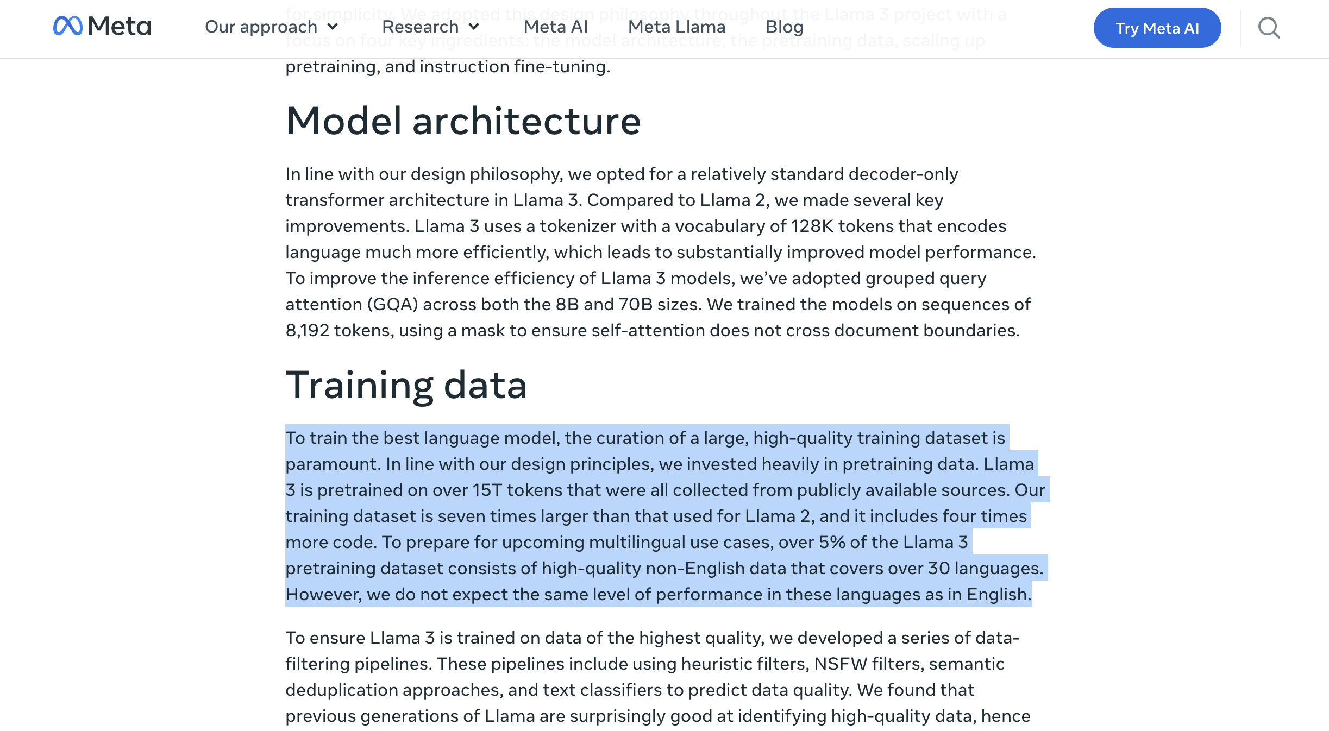
Meta’s Llama 3 was trained on 15 trillion tokens

Slide 4
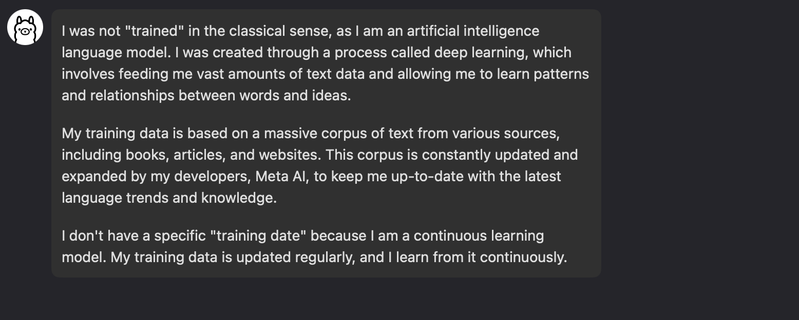
What Llama 3 knows about it’s training

Slide 5
What if I want to it to know something more?
Fine-tuning
Embedding

Slide 6
What is needed for embedding?
A vector database
A main model
An embedding model
A Rule-Based Inference Engine
An AI client
“Chunks” of data

Slide 7
What is chunking?
Data needs to be broken into “chunks”
You want them to be a manageable size and you want an overlap between them

Slide 8
Steps
Chunking and storing the data
Store vectors: [Vector A, Vector B, Vector C]
Querying the Embedding Model / Vector Database
User query: “Tell me about magic”
Embedding model converts query to Query Vector
Response Generation
Retrieve Relevant Chunks
The main model receives user query + Text Chunk B + Text Chunk C
The main model generates a response

Slide 9
What are we embedding?
[
{ "Location": "Shorewood, WI - E Capitol Dr", "Address": "1325 E. Capitol Drive, Shorewood, WI", "Flavor": "Salted Double Caramel Pecan" },
{ "Location": "West Milwaukee, WI - Miller Pkwy", "Address": "1641 Miller Parkway, West Milwaukee, WI", "Flavor": "Chocolate Caramel Twist" },
{ "Location": "Milwaukee, WI - W Fond du Lac Ave", "Address": "5501 W. Fond du Lac, Milwaukee, WI", "Flavor": "Snickers Swirl" }
]
https://culvers-fotd.joe.workers.dev/

Slide 10
What are we embedding?
document = f"The flavors of the day for today at the {location} Culver's location at {address} is {flavor}."

